Slide 1
Webpack
Core concepts

Slide 2
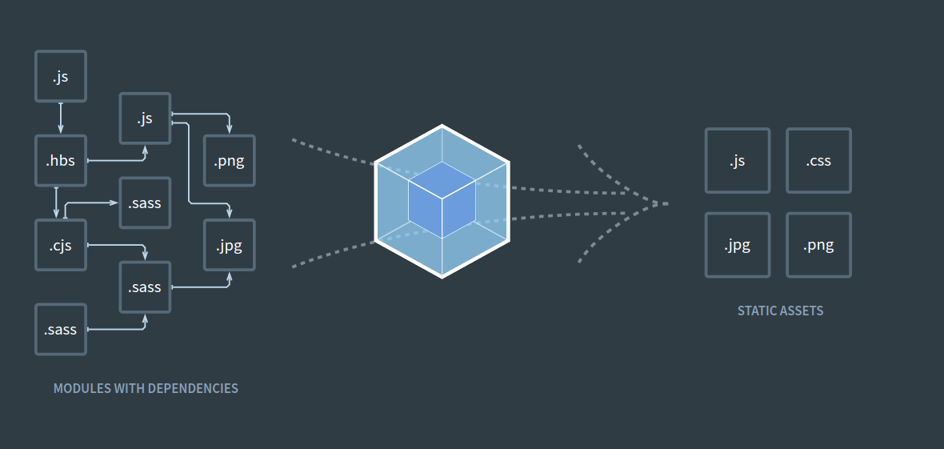
Webpack

Slide 3
Concepts
Entry
Output
Loaders
Plugins

Slide 4
Entry
module.exports = {
entry: './path/to/my/entry/file.js'
};

Slide 5
Multiple entries
const config = {
entry: {
pageOne: './src/pageOne/index.js',
pageTwo: './src/pageTwo/index.js',
pageThree: './src/pageThree/index.js'
}
};

Slide 6
Output
output: {
filename: 'bundle.js',
path: '/home/proj/public/assets'
}

Slide 7
Output for multiple entries
entry: {
app: './src/app.js',
search: './src/search.js'
},
output: {
filename: '[name].js',
path: __dirname + '/dist'
}

Slide 8
Loaders
module: {
rules: [
{ test: /\.css$/, use: 'css-loader' },
{ test: /\.ts$/, use: 'ts-loader' }
]
}

Slide 9
Loaders with options, multiple loaders
module: {
rules: [
{
test: /\.css$/,
use: [
{ loader: 'style-loader' },
{
loader: 'css-loader',
options: {
modules: true
}
}
]
}]}

Slide 10
Loaders example
json-loader - loads file as JSON;
raw-loader - loads raw content of a file (as utf-8);
file-loader - emits the file into the output folder and returns the (relative) url;
ts-loader - loads TypeScript like JavaScript;
html-loader - exports HTML as string, require references to static resources;
css-loader - loads css file with resolved imports and returns css code;
and many others...

Slide 11
Plugins
plugins: [
new webpack.optimize.UglifyJsPlugin(),
new HtmlWebpackPlugin({template: './src/index.html'})
]

Slide 12
Plugins examples
HtmlWebpackPlugin - easily create HTML files to serve your bundles;
UglifyjsWebpackPlugin - enables control of the version of UglifyJS in your project;
CompressionWebpackPlugin - prepare compressed versions of assets to serve them with Content-Encoding;
CommonsChunkPlugin - extract common modules shared between chunks;
and so on...

Slide 13
Q&A

